Slide 1
Lecture 15 –tkinter
CS2513
Cathal Hoare

Slide 2
Lecture Contents
Introducing TKInter

Slide 3
How Imports Work
Import allows us to use code in other modules
While often presented as “adding the code in a module to our program” – this is an oversimplification of the functionality
In reality import:
finds the module file - checks a number of locations for the module. If not found – exception!
Compiles it to byte code – in fact, this may not happen. If the latest compiled file (.pyc) is newer than the corresponding source then the file is not recompiled for efficiency.
Runs the module’s code as required – this is why we have a name check.
When we run a file, things that are defined are infact run and created in memory – they used until they are called; this is why we need a name check in modules we import.

Slide 4
The Search Path
The following locations are searched for a module:
The home directory of the program
PYTHONPATH directories
Standard Library directories
Contents of .pth files
The site-packages home of third party extensions

Slide 5
import
Identifies a module
e.g. import person ’imports the contents of our person.py module’
In reality, it identifies a module that we can reference in our code.
Supposing person had a function myfunc, then we could write:
import person
print(person.myfunc())
This has an advantage in helping us differentiate between functions from different modules that have the same name
We can also rename the module using as
import person as per
print(per.myfunc())

Slide 6
from x import y
from person import myfunc
Imports a function from a module and binds it to the current module.
It can be called directly without reference to the module.
from person import myfunc
myfunc()

Slide 7
What is tkinter?
tkinter is a light weight framework for developing user interfaces in Python
Ships with Python
Cross platform
Simple
Looks a ‘bit oldschool’
Coding is simple but relatively unsophisticated
Can be long winded and repetitive

Slide 8
Parts of an Interface
The basic components in the library are:
Basic Frame
Widgets (such as buttons, labels, lists, etc)
Layouts
Event handlers and event loop
To implement, we must:
Import components
Add components (widgets) into a layout
Add event handlers for widgets
Enter an event loop where we depart from the normal flow of control and enter an event driven model

Slide 9
Event Driven Program
Event-driven programming is a programming paradigm in which the flow of the program is determined by events such as user actions (mouse clicks, key presses);
Events are generated by the operating system and passed to the running application where they are translated into object instances (Event).
Here they are used to trigger event handlers where the event can be passed and values about the event accessed.

Slide 10
Creating a Frame
import tkinter as tk #Add the import
root = tk.Tk() #Create a frame object
root.geometry('400x400’) #Simple formatting
root.mainloop() #Enter the event loop
We create the frame and configure it
This creates a frame that can contain content.
Even with just this call we have a frame that can be
resized, closed, maximized, etc. It also has a title.
The event loop is entered with the mainloop call.
At this point, the programs flow of control becomes
dependent on user actions rather than executing
sequentially.

Slide 11
Adding Components
import tkinter as tk
root = tk.Tk()
root.geometry('400x400')
L1 = tk.Label(root, text='Some text’) # Adds a label to root
# initializes with some text
L1.pack() # Simple layout to add to frame
btn = tk.Button(root, text="OK") # Adds a button
btn.pack()
root.mainloop()

Slide 12
Event Handler
import tkinter as tk
def onclick():
L1.config(text = "Modified text") # The function that is called
# when the button is pressed.
# In this case updating the label
root = tk.Tk()
root.geometry('400x400')
L1 = tk.Label(root, text='Some text')
L1.pack()
btn = tk.Button(root, text="OK", command=onclick)
# We modify the button to name the method
# called when the button is pressed.
btn.pack()
root.mainloop()

Slide 13
But there is more…
To develop advanced code, we use designs or patters of development – these are known as Design Patterns.
These are established approaches for organising code for typical operations that we might have to implement
‘Design Patterns: Elements of Reusable Object-Oriented Software’ by Gamma, Vlissides, Helm and Johnson – also known as the ‘Gang of Four Book’
Often in a discussion in software company, you might be told to approach a problem using a particular pattern

Slide 14
Design Patterns
One pattern is called Model View Controller
It seeks to achieve a ‘separation of concerns’ – essentially decoupling the data representation from the interface
This makes it easy to present different views of the data to different apps
The Model is responsible for managing data in the application. It is manipulated by the controller and provides information to the view.
The Controller receives inputs from the user, validates those and makes changes to the model.
The View presents information to the user – several views of the same data can be presented

Slide 15

Design Patterns

Slide 16
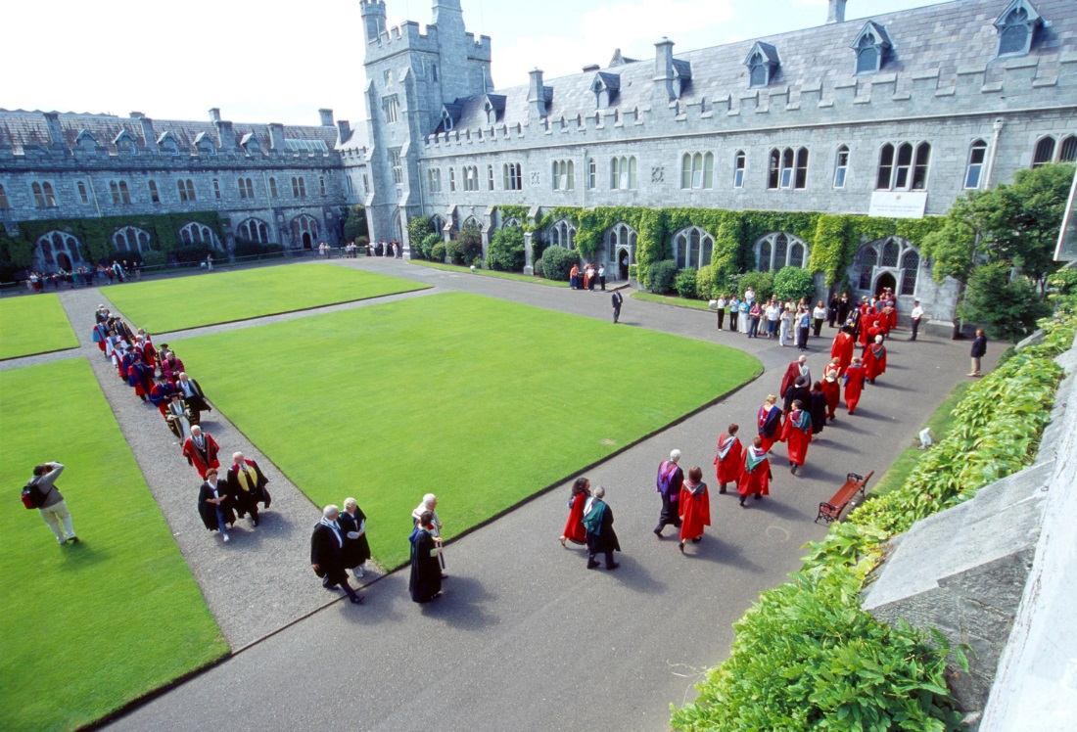
Next Time:
TKInter

